Slide 1
A SEMINAR PRESENTATION ON HEURISTC BASED HOME ENERGY MANAGEMENT SYSTEM
BY
ADEPOJU OLUWASEGUN
MATRIC NO: 188384
DEPARTMENT OF ELECTRICAL AND ELECTRONIC ENGINEERING, FACULTY OF TECHNOLOGY, UNIVERSITY OF IBADAN.
SUPERVISOR: DR. TR. AYODELE
Co supervised by Dr. ASO OGUNJUYIGBE
Oct, 2016.

Slide 2
INTRODUCTION
Energy systems facilitating power generation serves as the basic source of power for home appliances and industrial equipment’s use. There are several available Energy sources harnessed for power generation which could be succinctly classified into Non-renewable and renewable sources. These diverse sources enables various technique for power generation which engenders a variety of power generating systems. However, the low efficiency, unreliability and poor environmental friendliness of some generating systems poses more challenges than it solves hence, this brings about the idea of combining two or more alternative local energy generating systems which serves in complementing energy when the primary supply falls short of the required demand or when certain energy sources becomes unavailable. This also necessitates the movement towards a green technology which can alleviate the threats to climate change and improve the efficiency of such power systems.
Nevertheless, the performance of the generating facilities harnessing energy sources would not be fully optimized provided a significant part of the energy consumed is due to improper use of appliances and devices, leading to energy wastage. Residential and business buildings account for approximately 20% of the overall world-wide energy consumption, with an increasing trend over time. The main causes of energy consumption in buildings are space heating and conditioning, water heating, lighting, and the use of computers and other electronic devices. However, The major sources of energy wastage is exemplified by having electrical appliances in standby mode for long hours, having light bulbs left ON all through the day, underutilizing power generation facilities etc. Recent experimental study has shown that more than 30% of the generated energy is being wasted as a result of various forms of energy mismanagement.

Slide 3
While power systems and information technologies are converging to revolutionize the way electricity is generated, delivered, managed and consumed; new challenges arise such as: > how to integrate storage efficiently, > how to use demand-response of household appliances usage to mitigate peak demand, > how to Minimize or keep the energy consumption of the whole household as constant as possible, > how to minimize global fluctuations in energy consumption etc. this can be surmised as: how should resources be allocated in home energy management systems (HEMS) as the stochastic nature of their availability (generation, storage, and loads) becomes prevalent? As against the transmission level, where relatively few numbers of assets, although rated large, are used; the smart Home Energy management System (HEMS) is expected to transform distribution, where a multitude of smaller assets will be available for controlled deployment.
This research seeks to investigate the trend of stochastic supply of the National Grid within the immediate environment of the University of Ibadan, the available and affordable alternative renewable energy resources and propose a rule based smart home energy management approach that can harness the various energy facilities, predict and schedule electricity demand/supply by considering: the state of the smart grid, local power generation capacity, Energy storage units capacity and time-based electrical consumption of household appliances.

Slide 4
Problem Statement
The increased reliance on the deficient National power supply grid by the exponentially increasing building structures provokes further imbalance in the demand/supply structure as the present capacity of the national grid is without gain say insufficient to cater for the ever increasing demand for power. Hence, the movement to compensate household energy supply with energy sources such as PV. since the frequent, unexpected truncation of power supply engenders information loss, business interruption etc. However, with alternative local renewable energy facilities, power loss can be manually compensated while threats to climate change is reduced.
If there exists two or more renewable energy alternatives, a connection and reconnection problem arises in cases where energy sources are simultaneously used up and the next available source is connected. Hence a laborious routine of imperfect manual power scheduling; since the alternative energy sources might have different power ratings. This necessitates the need for a smart rule based Home Energy Management system.

Slide 5
RESEARCH AIM
This project aims to adopt a Heuristic approach for smart home energy management as a comprehensive solution, which takes account of the local renewable energy generation, smart grids, smart electronic appliances, and environmental factors. The approach aims to proffer a rule based solution to enhance energy management and minimize the overall daily electricity cost of household appliances, taking into account weather forecasts, predictable home activities, and the flexibility of electricity use.
The primary objectives of this project are:
To device a Rule Based load management approach which aims to:
Evaluate the stochastic variation in the National Grid/renewable energy supply
Use demand-response of household appliances usage to mitigate peak demand
Minimize/keep the energy consumption of the whole household as constant as possible and integrate storage efficiently.
To propose how resources should be allocated in home energy management systems (HEMS) as the stochastic nature of the availability of resources becomes prevalent.

Slide 6
METHODOLOGY
In order to achieve the stated objectives, the following approach are being taken:
A typical home setting will be adopted, and the stochastic variation in the availability of the accessible Renewable energy sources will be evaluated.
The total load obtainable due to the use of various appliances in practical scenarios will be formulated and with respect to time, the load usage is sorted into Peak and off peak load periods
With regards to the available renewable power, Schedulable Appliances will be defined and rules written to define their scheduled usage.
Automatic shifting of energy consumption from grid draw to renewable power in case of power outage (grid resilience) will be objectified by set of rules.
Set of rules which achieves the load/energy management by shifting/scheduling of loads and energy storage will be written
The proposed Fuzzy logic will be used to project the complex decision, and load scheduling with respect to the defined rules

Slide 7
METHODOLOGY
Load Model Structure
Basic Units of the model are
Household appliances Household types Household members
Classification of Household Appliances according to Home Activities Groups
Cooking - Microwave oven, Electric Stove / oven, Coffee Maker
Washing - Dishwashers, Laundry Washer/drier,
Cooling - Air conditioning
Refrigeration - Refrigerator and freezers
Entertainment - TV sets, VCR, Audio sets
Computer bay - PC, Laptop, Printer Wireless routers
Lighting - fluorescent lamps, filament lamps
Operating characteristics of home appliance used were found in:
Estimates of annual energy consumption of each appliance group. (available in the table of operating characteristics of electrical appliances in Buildings Energy Data Book of March 2012).
Table of hourly probability of use factors for different appliance group throughout the day.
Source: 2006 Nigeria Housing and Population Census

Slide 8
METHODOLOGY
Classification of Household Types
Households are classified according to 2006 National Population Census classifications
Classifications were are done based on
Income of household residents
technological penetration of the households residents:
Detach house-Lighting+Refrigeration+Entertainment+PCs+Washing+Cooking+Cooling
Semi detach house - Lighting+Refrigeration+Entertainment+PCs+Washing+Cooking +Cooling
Block of Flats -Lighting+Refrigeration+Entertainment+PCs+Washing+Cooking
Rooms / Let in House - Lighting+Refrigeration+Entertainment+PCs
Informal Improvised Dwellings - Lighting+Refrigeration+Entertainment
Traditional Hut – Lighting

Slide 9
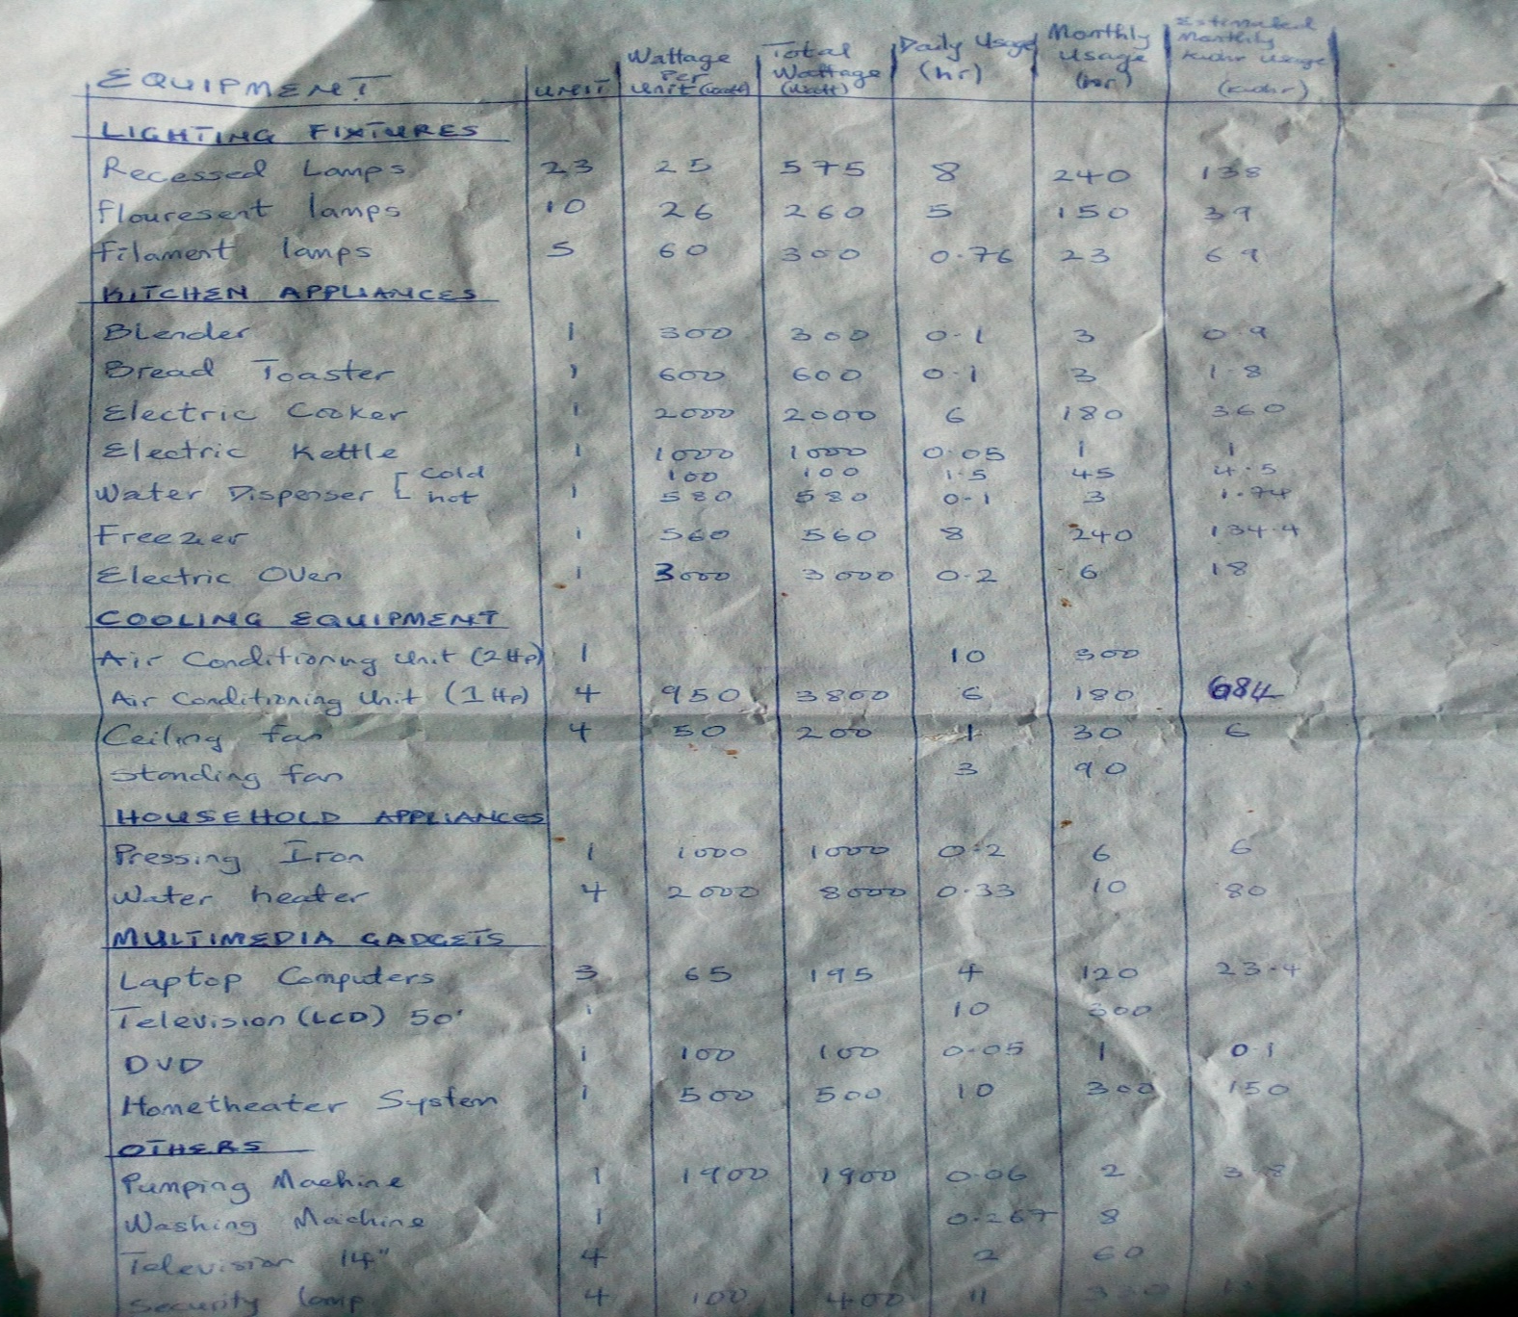
METHODOLOGY

Slide 10
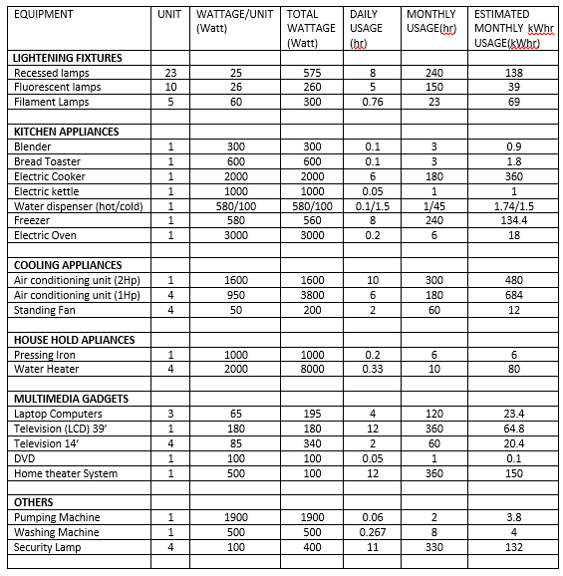
METHODOLOGY

Slide 11
Work done so far
A typical home setting was adopted, and the stochastic variation in the availability of the accessible Renewable energy sources has been hitherto evaluated.
The total load obtainable due to the use of various appliances in practical scenarios has been obtained and with respect to time, and the load usage was sorted into Peak and off peak load periods
The day is subdivided into 96 timeslots of 15 minutes each. For each appliance, with an evaluation of the load profile, that is, a set of successive timeslots with the corresponding amount of energy required. Given the load profile of each appliance (the time windows in which the appliances must be executed) the schedulable resources were highlighted
With regards to the available renewable power, Schedulable Appliances are being be defined and rules written to define their scheduled usage.

Slide 12
Work to be done
With regards to the available renewable power, Schedulable Appliances will be further defined and rules written to define their scheduled usage.
Automatic shifting of energy consumption from grid draw to renewable power in case of power outage (grid resilience) will be objectified by set of rules.
Set of rules which achieves the load/energy management by energy storage will be written
The proposed Fuzzy logic will be used to solve the complex decision, and load scheduling with respect to the defined rules

Slide 13
Conclusion
The proposed approach aims to provide a practical solution which take account of the local renewable energy generation, smart electronic appliances, decisions/commands of home owners, and environmental factors. It will allow an improved energy saving (efficiency) and cost reduction in homes by appropriately managing each single appliance and energy sources depending on the pre-defined rules.

